Slide 1
FANCY MECHANICAL FLOWER
DIGIFAB6
TRAN CHI LAN – ANNASTASIYA- NGUYEN NGOC QUOC DUNG - NGO TRUNG KIEN

Slide 2
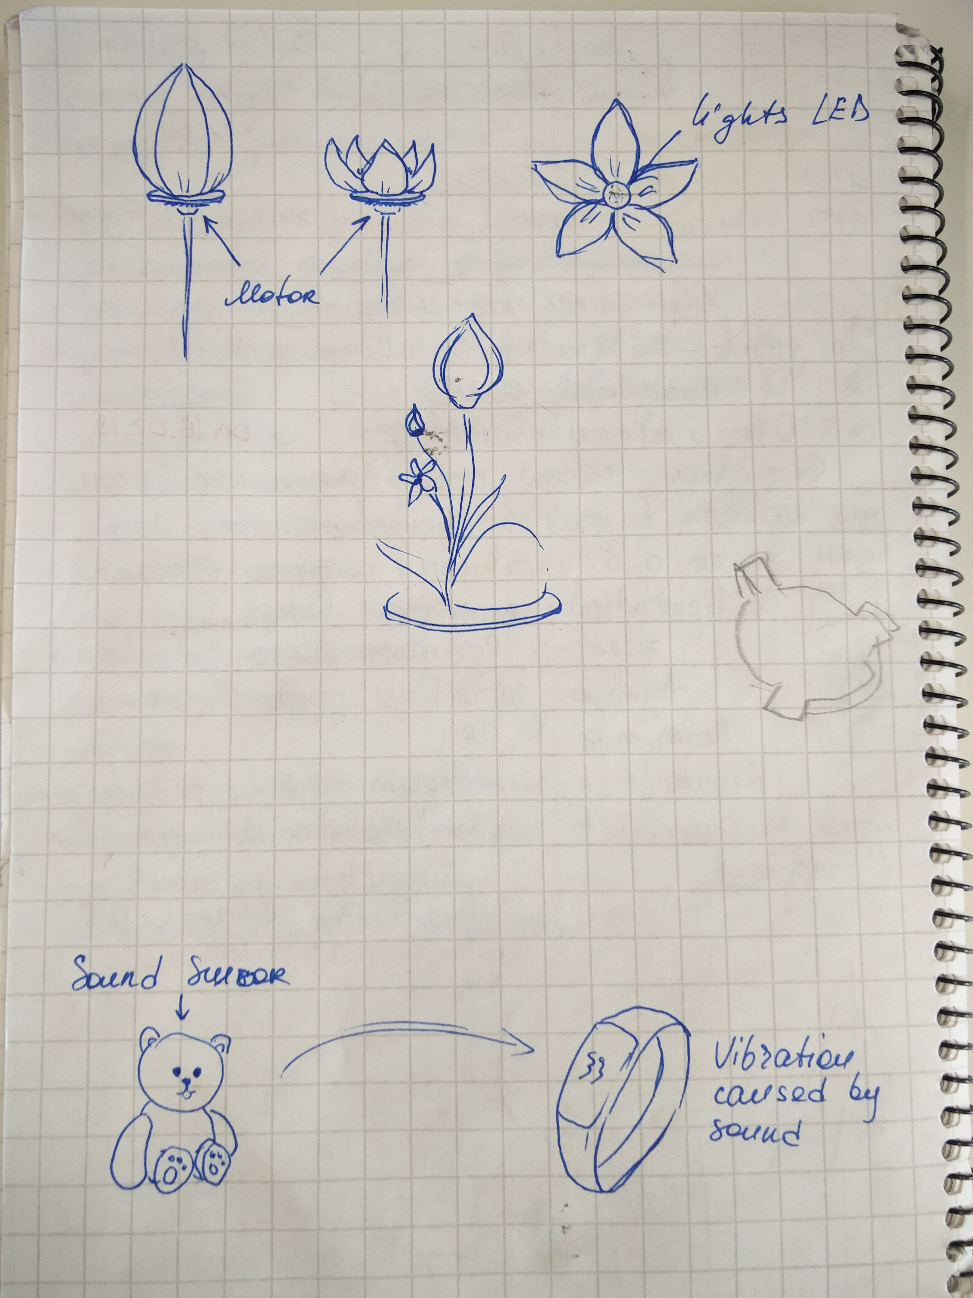
Arduino and Flower is two main concept of own project. Flower blooming when people touch it.
https://sites.google.com/view/pdf-flower-project/home

Slide 3
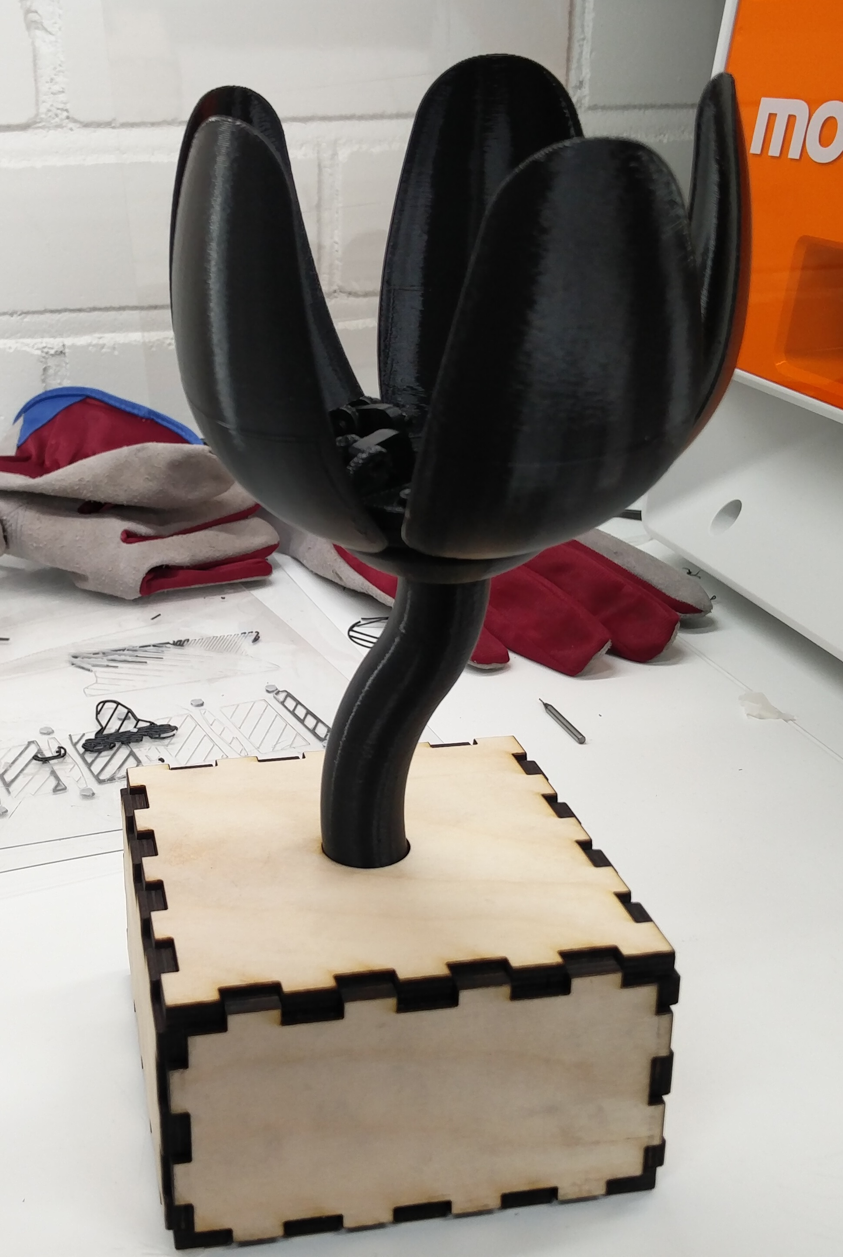
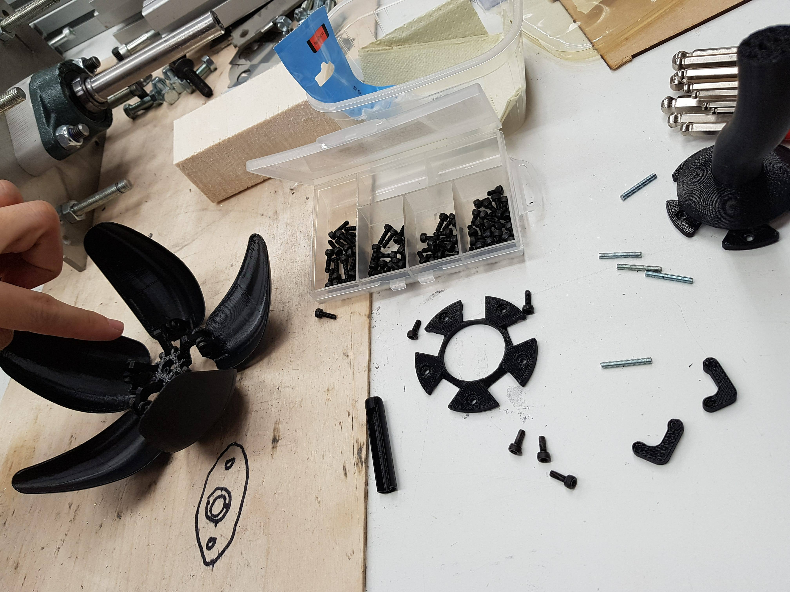
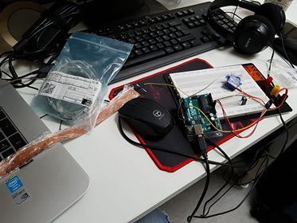
https://sites.google.com/view/pdf-flower-project/home

Slide 4
THANK YOU FOR YOUR ATTENTION
https://sites.google.com/view/pdf-flower-project/home

